Slide 1
Reactions and Rates 2 Clicker Questions
Activity 2:
Introduction to reaction kinetics
Trish Loeblein
PhET

Slide 2
Learning Goals
Students will be able to:
Describe how the reaction coordinate can be used to predict whether a reaction will proceed including how the potential energy of the system changes.
Describe what affects the potential energy of the particles and how that relates to the energy graph.
Describe how the reaction coordinate can be used to predict whether a reaction will proceed slowly, quickly or not at all.
Use the potential energy diagram to determine:
The approximate activation energy for the forward and reverse reactions.
The sign difference in energy between reactants and products.
Draw a potential energy diagram from the energies of reactants and products and activation energy.
Notes:
The concept questions only address some of these things; the textbook problems are used for reinforcement of many of these.

Slide 3
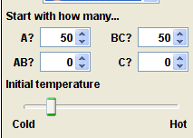
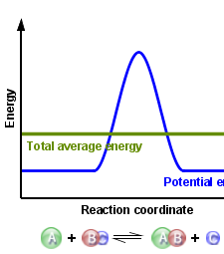
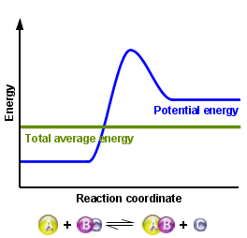
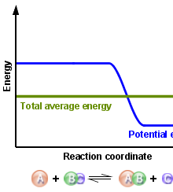
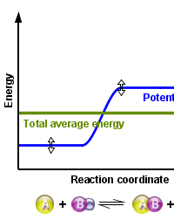
Which reaction would probably appear to be quickest?
A B C D
Notes:
B C because the reaction is exothermic and the first law of thermodynamics will predict more products. In addition, there is not enough activation energy for many reactants to reform

Slide 4
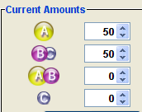
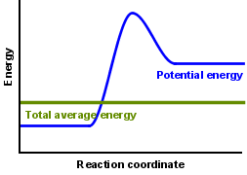
What would best describe what is in the container after several minutes have passed ?
Notes:
Answer choices on next slide

Slide 5
Answer choices
Container will have only &
Container will have only &
Container will have a mixture of all four with more &
Container will have a mixture of all four with more &
Notes:
D because there is not enough activation energy for many products to form

Slide 6
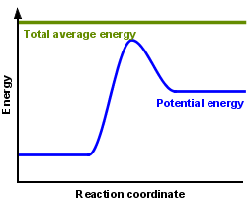
Using the heater would
Increase the number of &
Increase the number of &
Have no effect
Notes:
B because more collisions would have enough activation energy to form products and be stable with the higher energy required to maintain stability

Slide 7
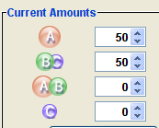
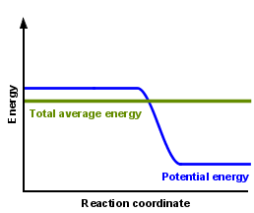
What would best describe what is in the container after several minutes have passed ?
Notes:
Answer choices on next slide

Slide 8
Answer choices
Container will have only &
Container will have only &
Container will have a mixture of all four with more &
Container will have a mixture of all four with more &
Notes:
C because the reaction is exothermic and the first law of thermodynamics will predict more products. In addition, there is not enough activation energy for many reactants to reform

Slide 9
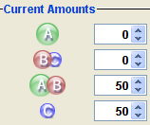
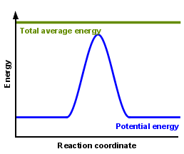
What would best describe what is in the container after several minutes have passed ?
Notes:
Answer choices on next slide

Slide 10
Answer choices
Container will have mostly &
Container will have mostly &
Container will have a mixture of all four with nearly equal amounts
No reaction will occur since the products and reactants have the same energy
Notes:
C because the reaction is thermally neutral, the first law of thermodynamics will predict equal products and reactants since there is enough activation energy for reactants to form

